Slide 1
Lexical Analysis
[20 pts.] Construct minimum-state DFA for the following regular expression: (ab)*(a|b)：
Convert the regular express into NFA first. [6 pts.]
Convert the NFA into DFA by subset construction. The Transition table is required. [8 pts.]
Minimize the state of DFA. [6 pts.]

Slide 2
Construct NFA for each basic regular expression
1. NFA for ε
ε
start
x
y
2. NFA for single character a
a
start
x
y

Slide 3
Construct NFA for complex regular expressions
(1) The NFA for regular expression “e” is
e
start
x
y
(2) Break up the NFA basing on the following three operations until the arrowed line is labeled by only characters
e₁
e₁
e₁
e₂
ε
ε
start
X
y
start
X
1
y
start
X
1
y
e₂
e=e₁|e₂
e=e₁e₂
e=e₁*

Slide 4
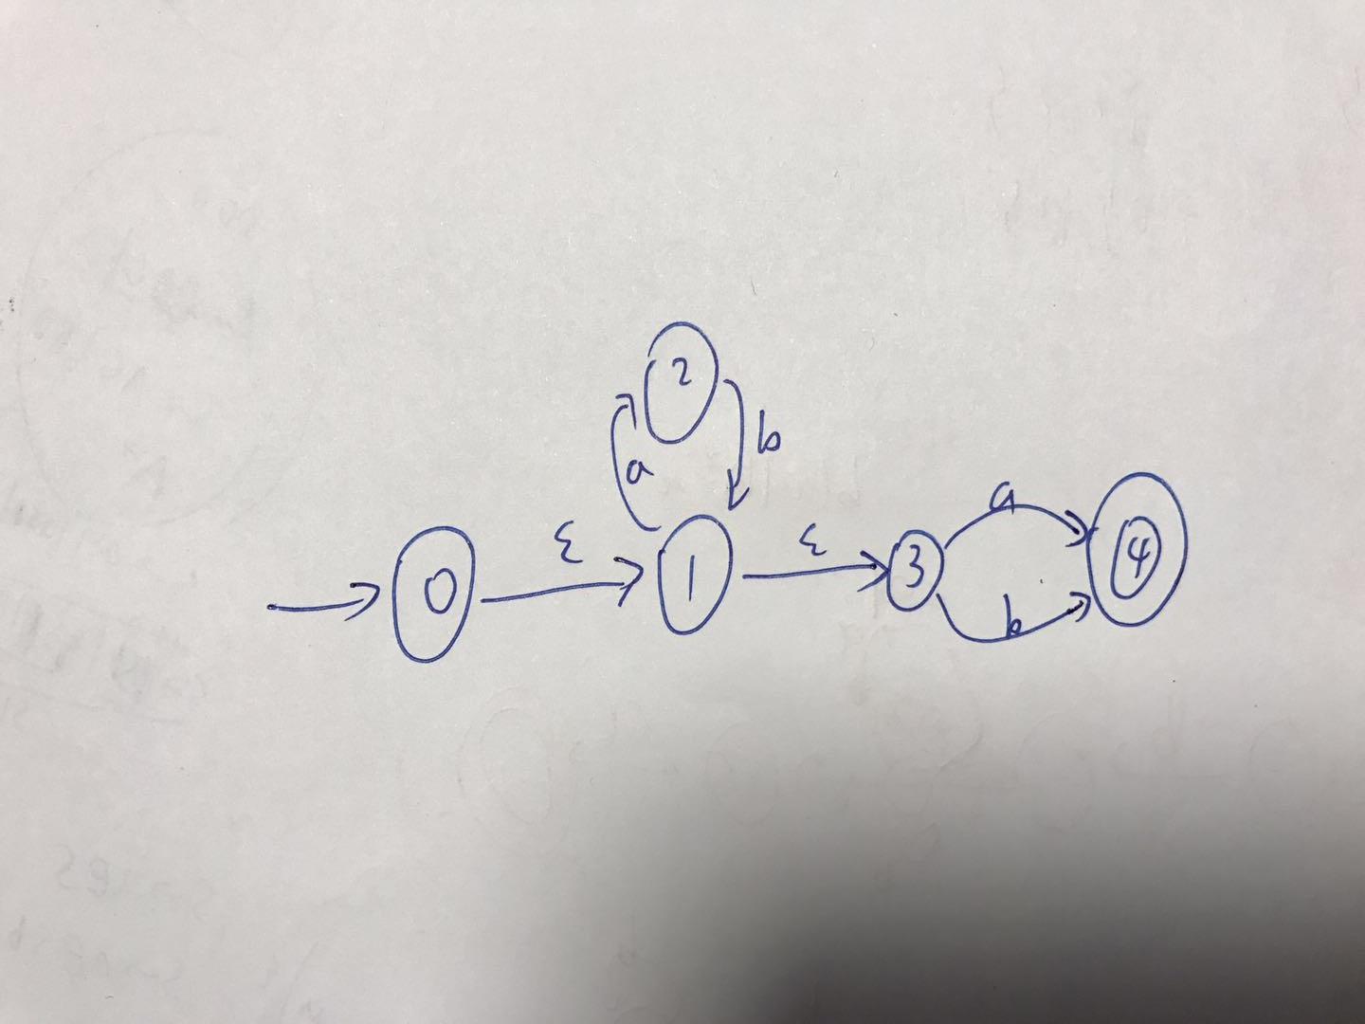
Lexical Analysis
1 Convert the regular express into NFA

Slide 5
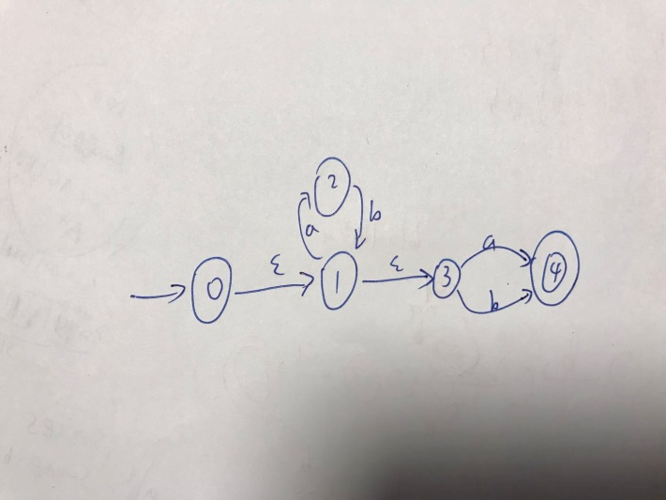
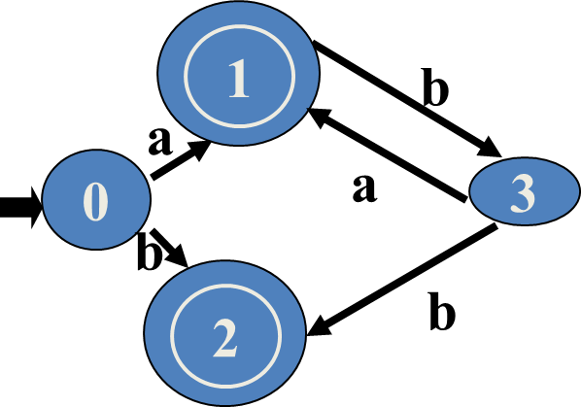
Lexical Analysis
2 Transition table:
DFA:
I | Ia | Ib | Accept
{0,1,3} T0 | {2,4} T1 | {4} T2 | no
{2,4} T1 |  | {1,3} T3 | yes
{4} T2 |  |  | yes
{1,3} T3 | {2,4} T1 | {4} T2 | no

Slide 6

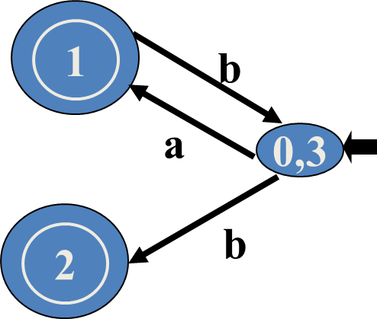
Lexical Analysis
3 minimal DFA:
{0, 3} {1} {2}
0 and 3 are equivalent states, merge them into a state {0,3} of the minimal DFA.

